Slide 1
From Advising to Impact
Governing for Scalable Student Success
CCATT Annual Meeting
September 12th, 2025

Slide 2
Session Agenda
Presenting the case for advising reform
Identification of student barriers
Conducting needs assessment
Trustee oversight framework
Implementing innovative advising
Expanding strategic initiatives

Slide 3
The Case for Advising Reform
Manual and paper-based processes
Inability to track student progress to completion
Students delaying graduation
Lack of awareness of financial aid status
Difficulty in transition from high school to college

Slide 4
Student Barriers
Lack of knowledge of degree plans and courses
Difficulty understanding financial aid eligibility
Taking courses not counting toward graduation
Financial stresses and family responsibilities
Lack of a clear pathway to career and completion

Slide 5
Conducting a Needs Assessment
People
Processes
Techology

Slide 6
Trustee Oversight Framework
How does this align with the College’s Strategic Plan?
What metrics define success (enrollment, persistence, completion)?
How are we sustaining leadership and reform momentum?
How do we balance consistency with personalization in student support?

Slide 7
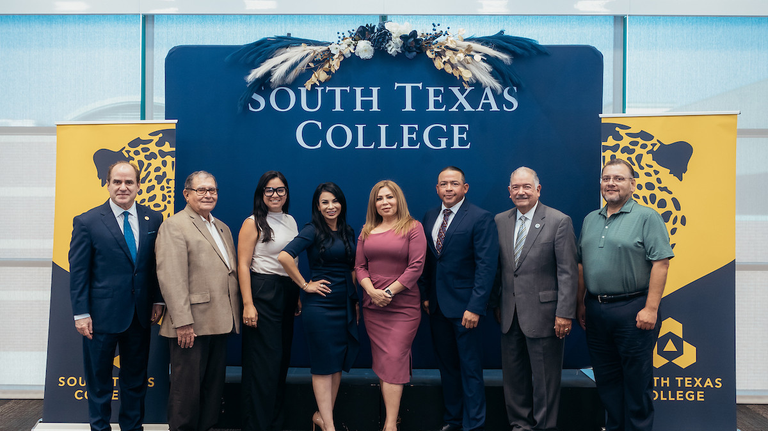

Slide 8
Innovative Advising Model
Holistic and student-centered
Coaching and mentoring
Case management
One-stop shop
Financial aid, application, TSI status
Access to high school counselors
Philanthropic support

Slide 9
Financial Barriers Stop Outs
71%
44%
35%
Receive Financial Aid
Former Students Stopped Out Due to Financial Issues
Struggle to Pay Bills
Sources:
2025 STC Student Financial Services Data
2024 Trellis STC Re-Engagement Survey
2024 STC Survey of Entering Student Engagement (SENSE)

Slide 10
JagReconnect
Program Components:
Personalized Coaching and Mentoring
Case Management and Monitoring of Academic Progress
Covers Tuition for Remaining Courses if Close to Completion
Wrap-Around Services

Slide 11

JagReconnect Program Success Rates
7.3%
37%
10%
19%
Reenrollment
Persistence
Transfer
Graduation

Slide 12
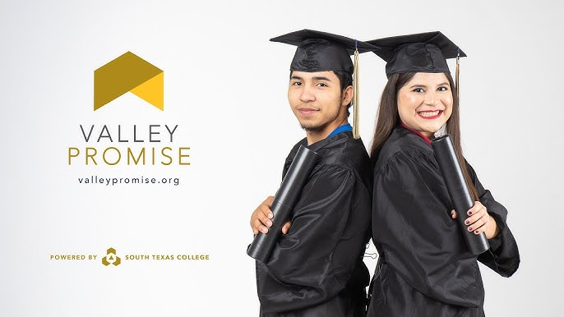

Slide 13

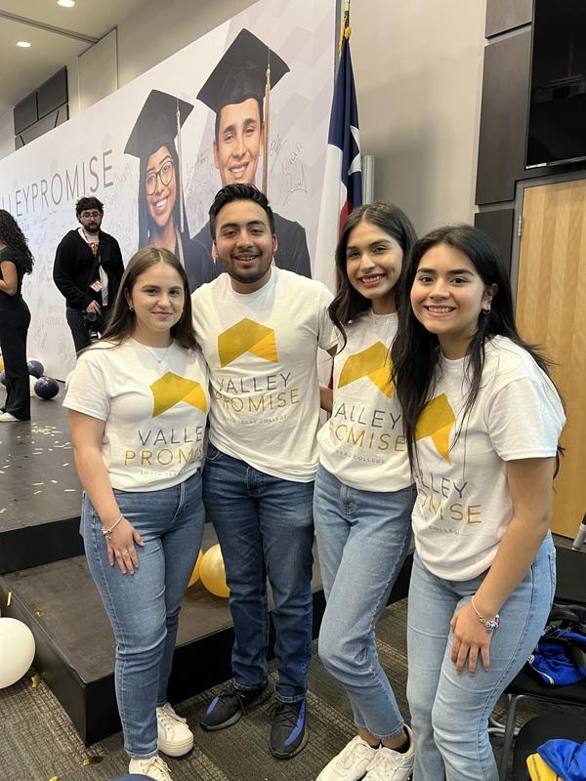

What is Valley Promise?
Last-dollar match through completion of up to two years or completion of associate's degree
Personalized support, academic coaching, and mentoring
Designed to increase college access and completion-and connect students to meaningful careers and workforce opportunities

Slide 14
Student Profile
First generation students
First Time in College
Prior Dual Credit
Low socioeconomic status

Slide 15

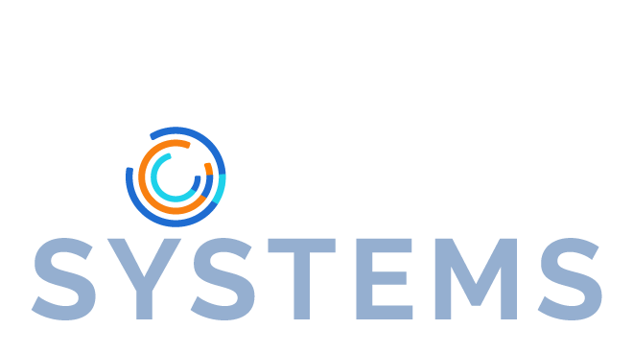
The following regional collaboratives represent the potential to impact 50% of Texas HS Grads
(1 in 25 American HS Graduates)
Texas
Region | HS Grads
Dallas (Dallas County Promise) | 30,000
Tarrant (Tarrant To and Through) | 23,000
Texoma (Grayson College) | 1,700
Red River (North Central Texas College) | 800
Tyler (Tyler Junior College) | 3,500
Bexar (Alamo College Promise) | 22,000
Howard College | 900
Odessa College | 4,000
Navarro College | 5,000
Austin 2030 (City of Austin) | 5,000
South Texas College | 15,000
Harris (Greater Houston To and Through) | 55,000
Total | 165,000
Economic Mobility Systems

Slide 16
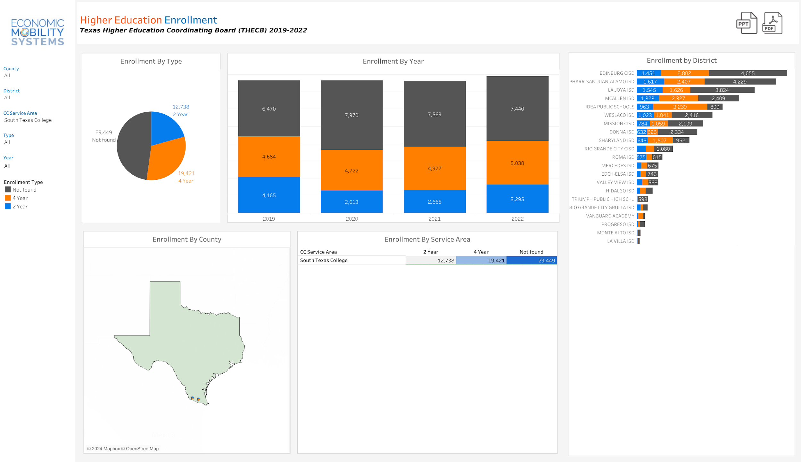
Matriculation Data

Slide 17
Program Requirements
Complete the ApplyTexas application and submit FAFSA/TASFA application by July 1.
Submit the Promise Pledge by June 1
Register for Fall classes and select 12 credit hours of courses by July 1.

Slide 18
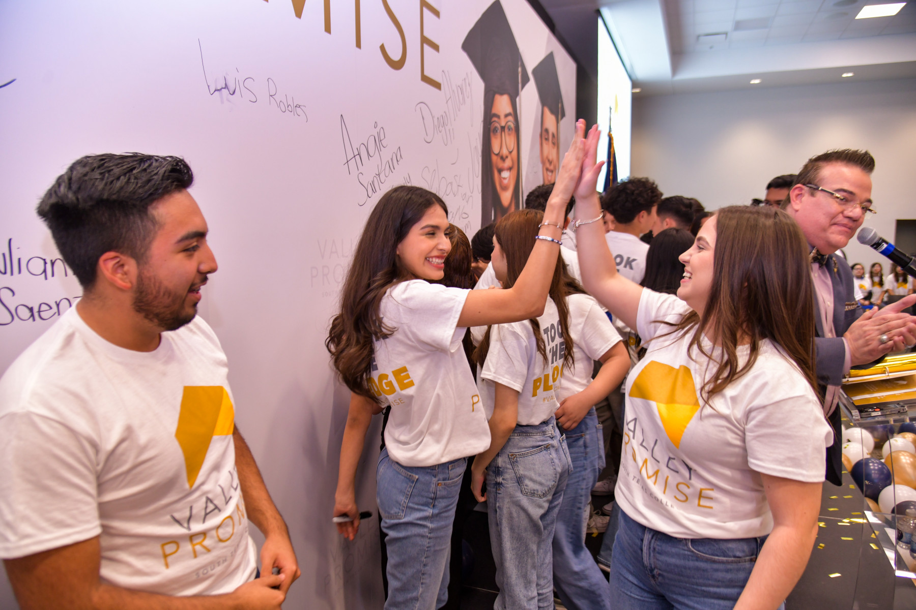
The Pledge: What It Means for Students
Students commitment to enrolling at STC
Recruiters work with students to complete enrollment process earlier in the Senior year
Year-round messaging targets both students and parents

Slide 19



BENEFITS FOR STUDENTS
TUITION GRANTED
COACHING AND MENTORING
PERSONALIZED SUPPORT

Slide 20
Student Enrollment and Engagement
Senior Year
  Fall - Application, FAFSA, Pledge
  Spring - All Access (Registration)
  Summer – Recruiter Case Load/Community Pop Up Registration
First Year
  Resource Fairs
  Advisor Meet and Great
  Career Preparation
  Tools and Tips for Scholars Success
  Meet the Director

Slide 21
Salesforce
Pledge
Allows real-time tracking and monitoring of student enrollment
Customized communications guide students through enrollment process
Targets both students and parents
Two (2) licenses provided to each high school
Registration
Admission
Financial Aid

Slide 22
Data-Driven Decision Making
Cohort tracking
Real-time analytics and metrics
Quantifiable outcomes for recruiters
Enrollment trend analysis

Slide 23
Week of | Total Targeted | Total Pledges | Enrolled | % Change | Enrolled Meeting All Requirements | %Change
4.7.25 | 13,876 | 2,811 | 461 | 110% | 0 | 0%
4.21.25 | 13,979 | 3,033 | 840 | 19% | 302 | 0%
5.5.25 | 14,050 | 3,253 | 1,274 | 14% | 773 | 18%
5.19.25 | 14,050 | 3,327 | 1450 | 7% | 876 | 0%
6.2.25 | 14,333 | 3,519 | 1,758 | 7% | 1,281 | 12%
6.16.25 | 14,389 | 3,570 | 2,130 | 5% | 1,371 | 5%
7.7.25 | 14,530 | 3,632 | 2,442 | 15% | 1,524 | 11%
7.14.25 | 14,580 | 3,678 | 2,442 | 5% | 1,524 | 8%
7.21.25 | 14,580 | 3,792 | 2,686 | 10% | 1,752 | 15%

Slide 24
Seamless Student Experience
Onboarding
Summer Bridge
Case Management
First Year Engagement Activities
Hand-off to Academic/Technical Program

Slide 25
Core Strategies
Dual enrollment matriculation
Financial support and financial aid timeline
Degree pathways
Partnerships with high schools
Parental Support and involvement

Slide 26
Partnership Framework
School districts
Regional educational service center
Community organizations
Regional and national philanthropy
Business and industry

Slide 27
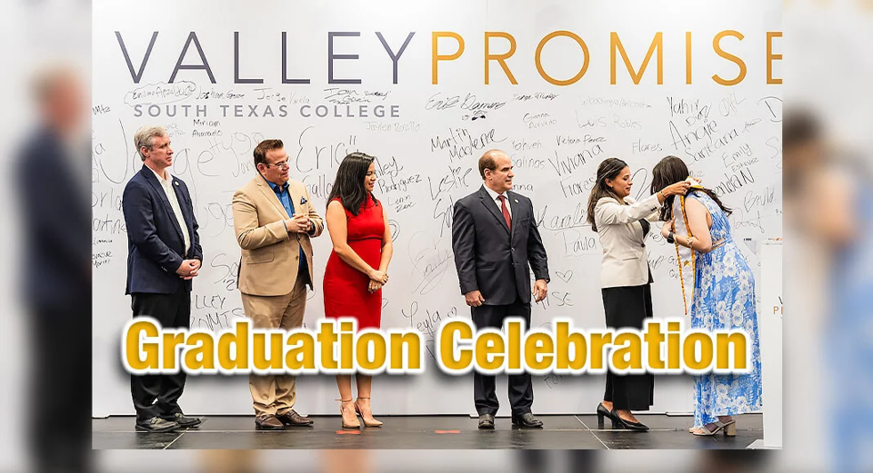

Slide 28
Key Takeaways for Trustees
Institutional reforms are strategic investments, not just operational upgrades
Governance alignment and support enable scale and sustainability
STC provides a replicable model for reform tied to outcomes
Trustees play a pivotal role in ensuring every student ‘experiences exceptional’

Slide 29
Q&A
Melissa Peña-Montes
Director of Promise Program and Enrollment Management
mpena270@southtexascollege.edu
Dr. Matthew Hebbard
VP for Student Affairs and Enrollment Management
mshebbar@southtexascollege.edu

