Slide 1
Elevating Impact: Harnessing Credentials of Value and Workforce Data for Community College Success
David Troutman, Deputy Commissioner of Academic Affairs

Slide 2
Please download and install the Slido app on all computers you use
How would you rate your level of knowledge on the Credentials of Value (COV) Baseline methodology?
ⓘ Start presenting to display the poll results on this slide.

Slide 4
Please download and install the Slido app on all computers you use
How would you rate your level of knowledge on the Credentials of Value (COV) Premium methodology?
ⓘ Start presenting to display the poll results on this slide.

Slide 5
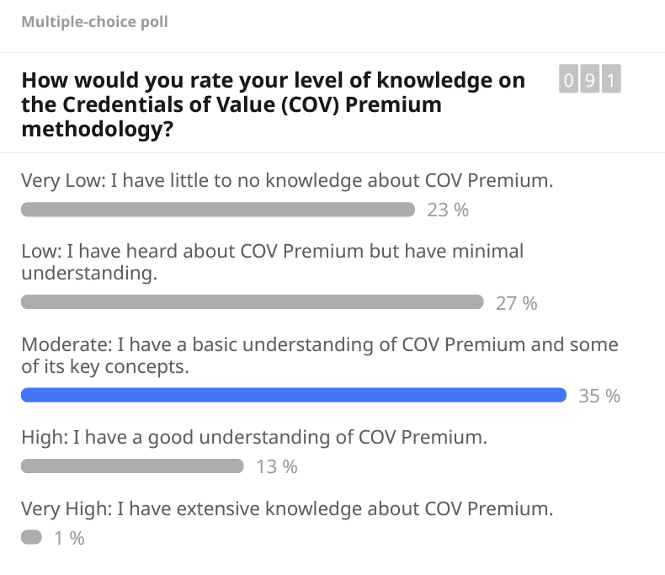

Slide 6
Credential of Value (Baseline)

Slide 7
Unpacking Credentials of Value: FY24 Funding Details
DEGREES & CERTIFICATES: COSTS
AID
INVESTMENT
-
=
+
x
Net cost of attendance
Opportunity cost (foregone wages)
Time (based on program design)
Aid received (grants, waivers, scholarships)
TOTAL STUDENT INVESTMENT

Slide 8
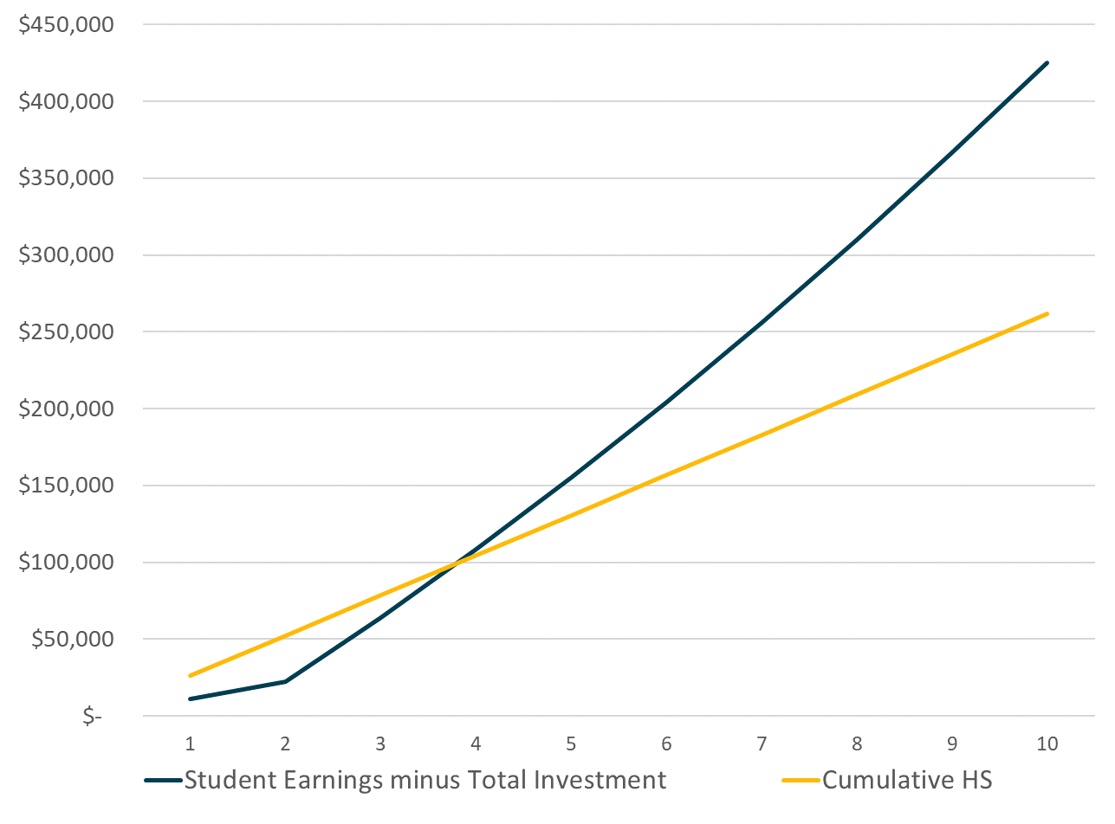
COV Baseline: Student ROI vs high school graduates
FOR FY '24:
100% of reported degree and certificate programs are Credentials of Value
Modeling makes assumptions about time to degree and student wages
Initial 10-year time horizon to break even

Slide 9
COV Baseline: Student ROI vs high school graduates
FOR FY '24:
100% of reported degree and certificate programs are Credentials of Value
Modeling makes assumptions about time to degree and student wages
Initial 10-year time horizon to break even

Slide 10
Credential of Value (Premium)

Slide 11
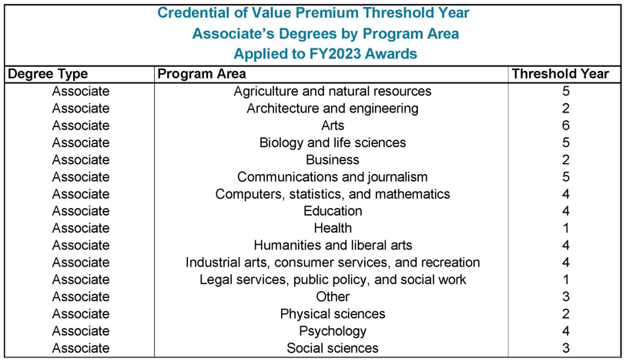
COV-Premium Identifying Breakeven Years:

Slide 12
THECB Data Landscape

Slide 13
THECB Data Sources
State Sources
National Sources
State Data Reports
THECB, TEA, and TWC
CCF Financial Model Simulation Tool (What If)
Secure Dashboards (Persistence and Graduation, Transfer, and Labor Outcomes)
Texas Talent Trajectory (T3)
Bureau of Labor Statistics (BLS)
Integrated Postsecondary Education Data System (IPEDS)
American Community Survey (ACS)
Postsecondary Employment Outcomes (PSEO)
Lightcast

Slide 14
CCF – Financial Model Simulation

Slide 15
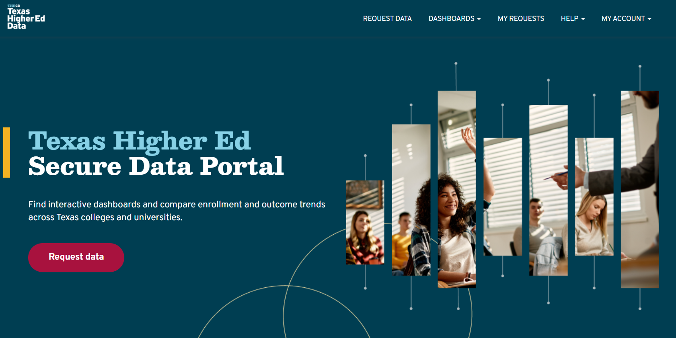
Secured Data Portal

Slide 16
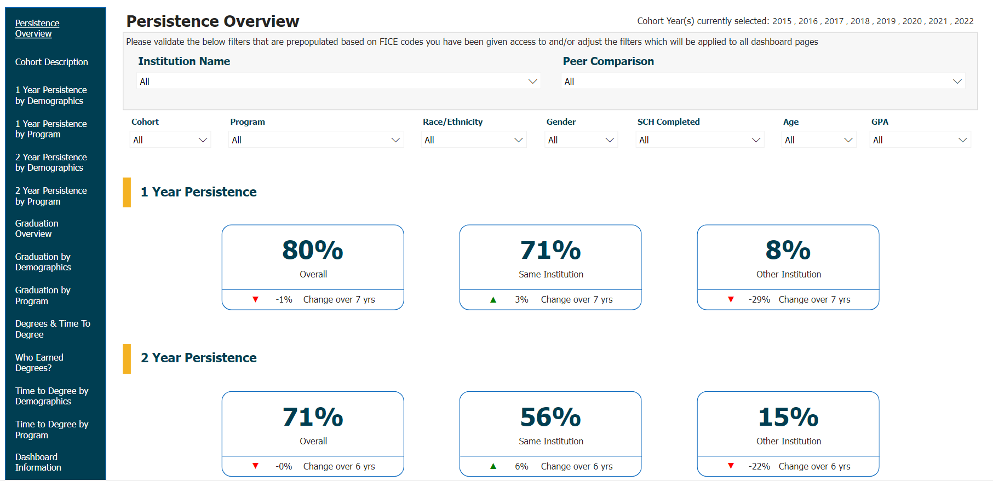
Secured Data Portal

Slide 17
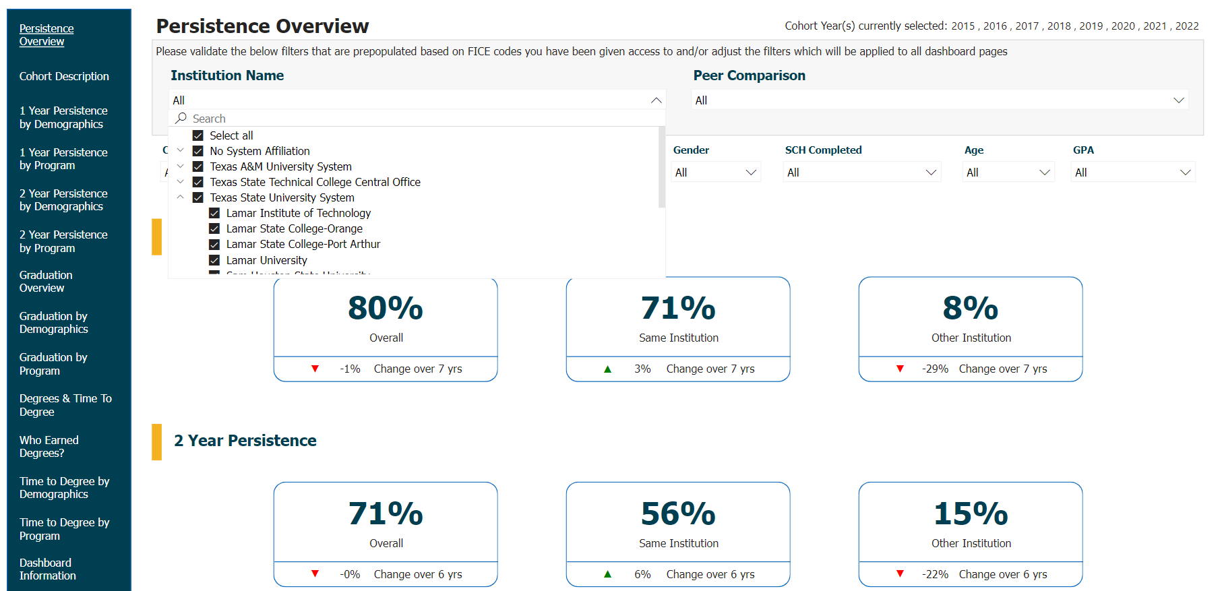
Secured Data Portal

Slide 18
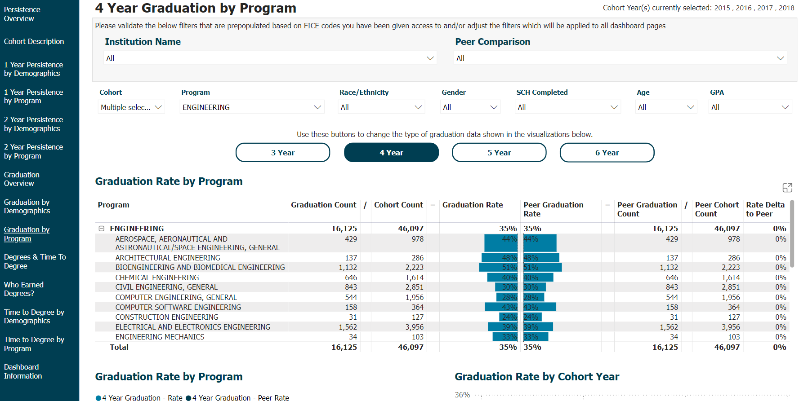
Secured Data Portal

Slide 19
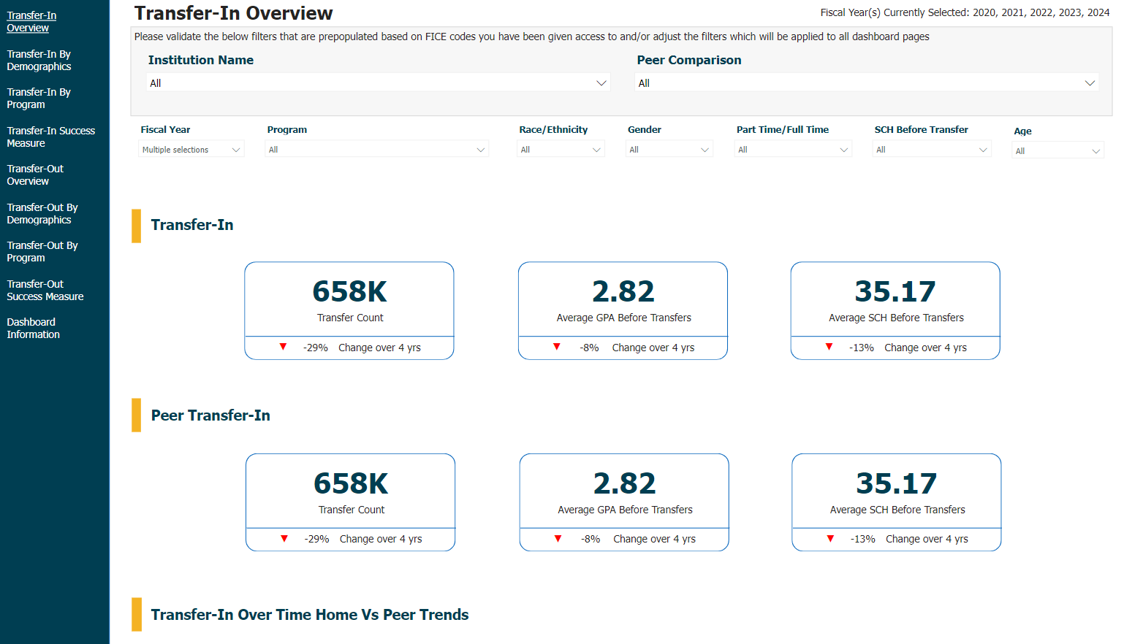
Secured Data Portal

Slide 20
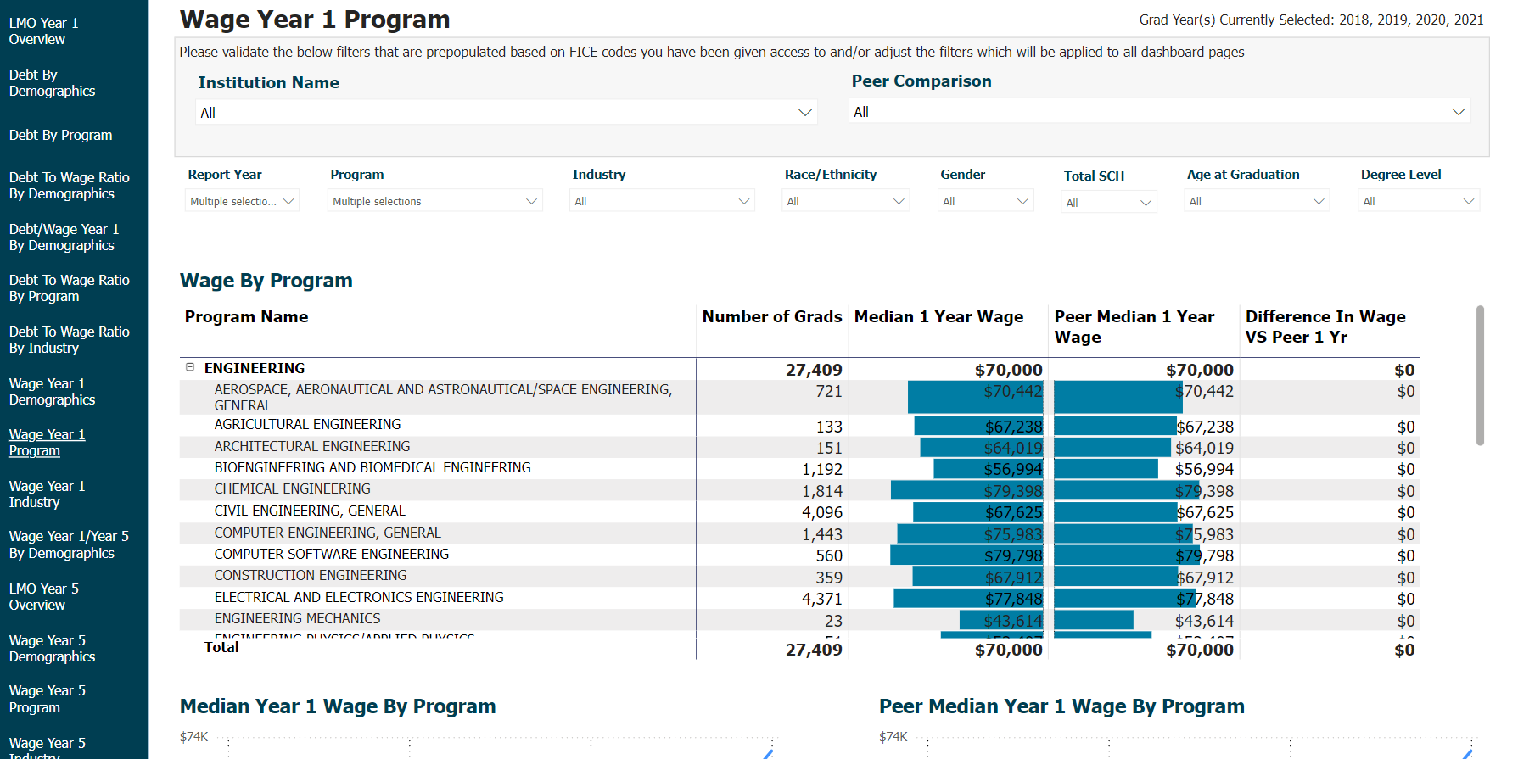
Secured Data Portal

Slide 21
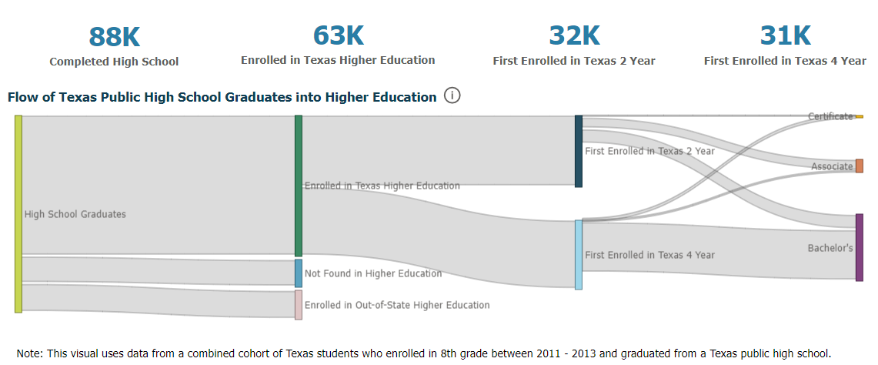
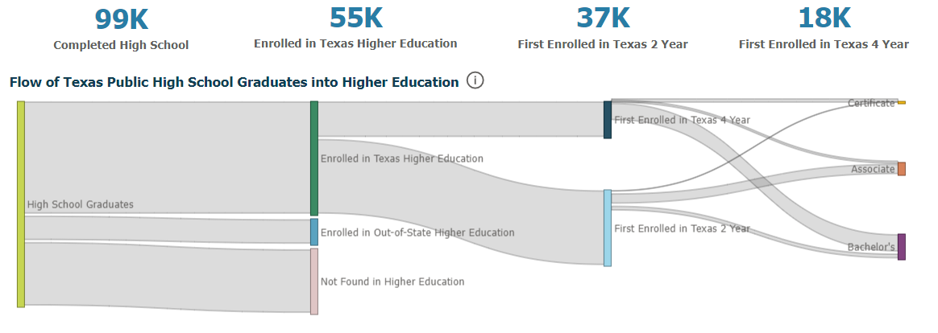
Texas Talent Trajectory (T3)
Region A:
Not Economically Disadvantaged
Region A:
Economically Disadvantaged

Slide 22
Please download and install the Slido app on all computers you use
Do you leverage THECB Secure Dashboards?
ⓘ Start presenting to display the poll results on this slide.

Slide 23
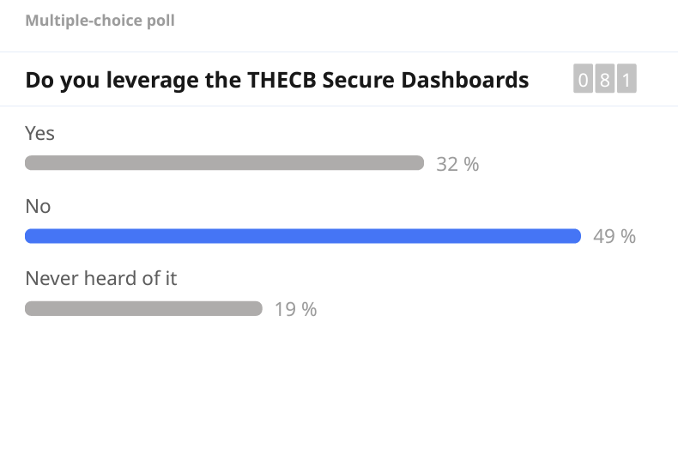

Slide 24
Community College Finance HUB

Slide 25
CCF Data Hub
Data Hub: a central library that connects all data sources into one location
Gain deeper insights into student performance, demographic trends, workforce needs, and more
Enhance response time to changing educational and workforce landscapes
Snowflake (modern data platform)
Data storage, processing, and analytics needs
Robust security, seamless data sharing, and cost-effective
Interface with customized dashboards
Snowflake Marketplace
Access a wide variety of third-party data sets and data services directly within Snowflake.
Population trends, economic indicators, job market trends, employer needs,

Slide 26
Please download and install the Slido app on all computers you use
What is the biggest challenge your institution faces in aligning academic credentials with workforce demands?
ⓘ Start presenting to display the poll results on this slide.

Slide 27
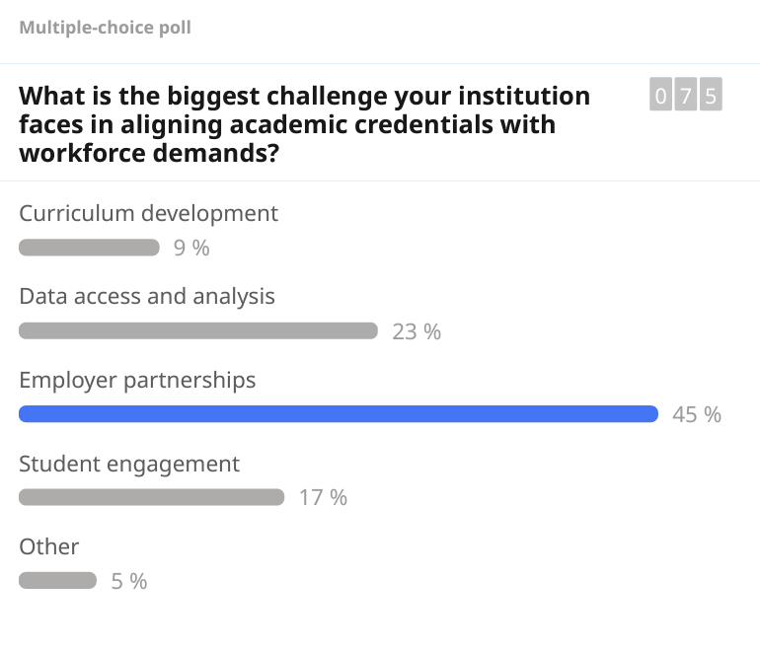

Slide 28
Please download and install the Slido app on all computers you use
What component of the Community College Finance Hub do you think will be most beneficial for your institution?
ⓘ Start presenting to display the poll results on this slide.

Slide 29
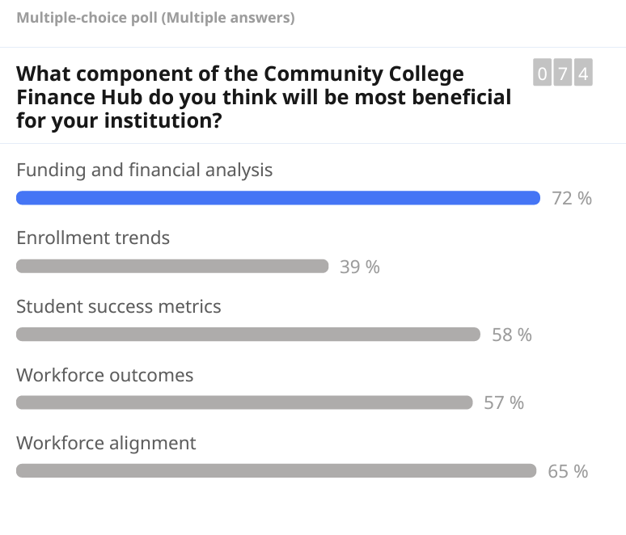

Slide 30
Please download and install the Slido app on all computers you use
Which area would you like to see most customized for your institution in the CCF Hub?
ⓘ Start presenting to display the poll results on this slide.

Slide 31
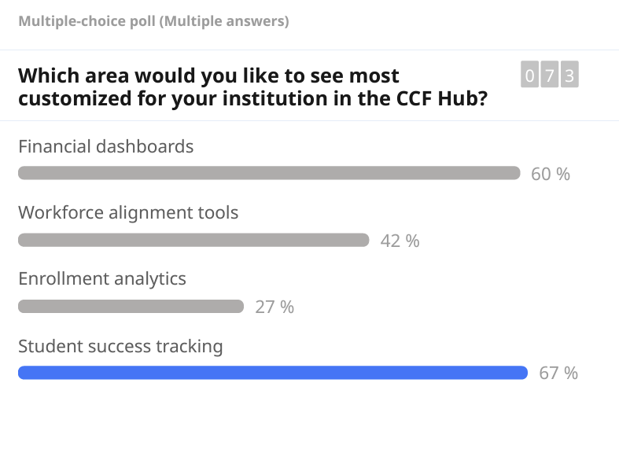

Slide 32
Please download and install the Slido app on all computers you use
What roles at your institution should participate in collaborative efforts to enhance the CCF Hub and its tools?
ⓘ Start presenting to display the poll results on this slide.

Slide 33
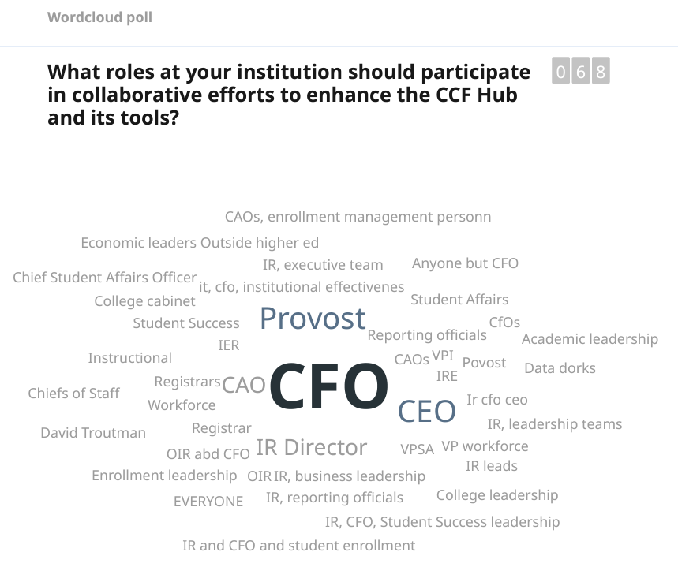

Slide 34
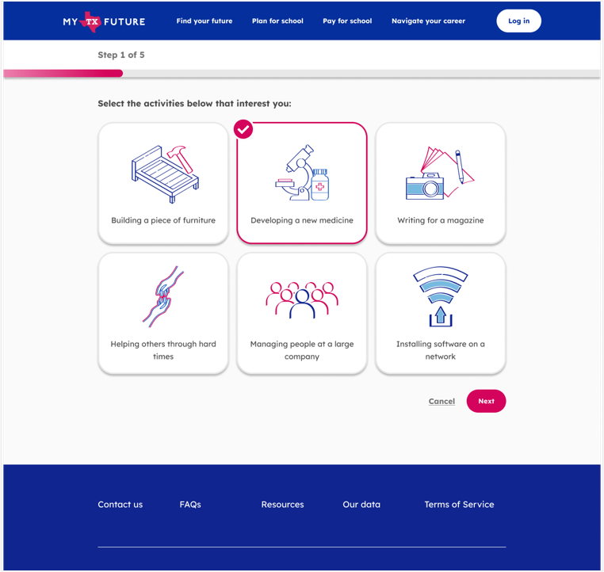
My Texas Future Connecting K-12 Learners and Adults to Higher Ed
My Texas Future serves as a one-stop college and career navigation tool for all Texans
Scan for access to mytexasfuture.org
My Texas Future streamlines the college and career navigation process for learners.

Slide 35
Course Sharing
Membership in a Course Sharing Partnership Program fostering community among participating institutions, creating collective guidelines, and providing a robust foundation for success.
Access to a Course Sharing Platform (at no cost)
Centralized Support assisting institutions in technology implementation, change management, and critical course sharing operations.
As of now, 520 Courses slated for Fall 2024
Course sharing is designed to reduce barriers and to assure that student success is optimized (reduce time to degree)
Assistant Commissioner for Digital Learning, Michelle Singh, Ph.D., will be here on Friday talking to you about our AI initiatives.

