Slide 1
Equity-Minded Professional Development at Temple College
Dr. Susan Guzmán-Treviño
Provost, Vice President, Academic Affairs and Student Services

Slide 2
Temple College: Pathways Journey
Essential Practices:
Clarify paths to meet student end goals.
Help students choose and enter a pathway.
Help students stay on their path.
Ensure students are learning.

Slide 3
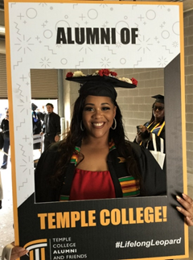
Objectives
Background: Temple College
Equity Journey
Dr. Brown-McNair
Faculty Fellows
Micro-grants
Peer Review
Center for Teaching and Learning
Student Voices
Opportunities

Slide 4
LEADERSHIP TRAINING
EQUITY
AUGUST 11, 2020

Slide 5
Dr. Tia Brown McNair
Dr. Tia Brown McNair is the Vice President in the Office of Diversity, Equity, and Student Success and Executive Director for the Truth, Racial Healing, and Transformation (TRHT) Campus Centers at the Association of American Colleges and Universities (AAC&U) in Washington, DC.
Funding Provided By Trellis Foundation

Slide 7
FALL 2020 BOOK CLUB

Slide 8
Center for Teaching and Learning
Equity Fellowship 2021

Slide 9
Presentation with Lauren Goodman
Dean of Teaching and Learning Innovation, Berkshire Community College
lgoodman@berkshirecc.edu; 413-236-2161

Slide 10
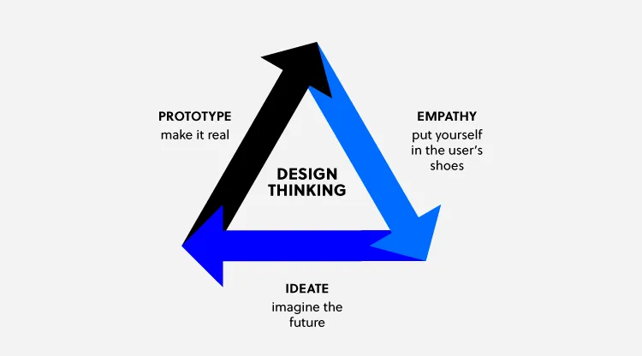
Design Thinking Workshop
A design thinking workshop is a creative problem-solving session that is based on the principles of design thinking. The activities of a design thinking workshop are organized according to the three phases of the design thinking process: empathy, ideation, and prototyping.

Slide 11
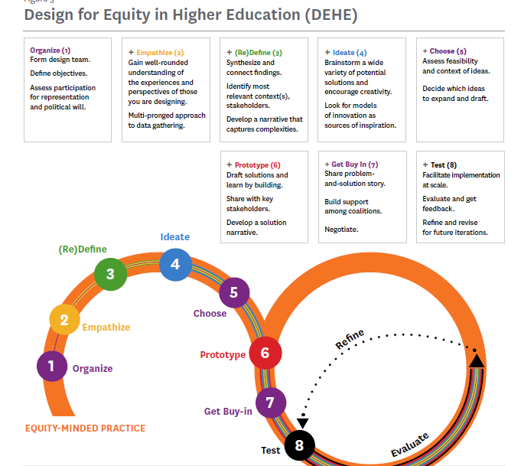
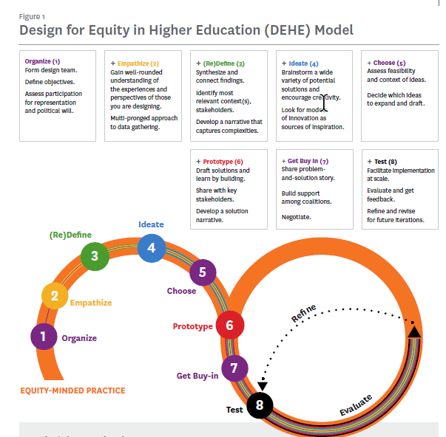
Design for Equity in Higher Education, Pullias Center
(Email me if you would like access)

Slide 12
Stages of a Design Thinking Workshop
Organize/Empathize: Gather a team. Develop a deep understanding of the problem that users face and empathize with them.
Stage 1: Today through June 24
Define/Ideate/Choose: Define goals/terms. Brainstorm solutions, look for models, and choose based on feasibility. Develop solutions.
Stage 2: June 24 through July 22
Prototype/Test: Draft solutions and then test it with real users.
Stage 3: July 22 through August 3 (and through Fall 2021)
Meeting in November 2021--Update: What worked? What didn’t?
Buy-in/Test: Present to faculty

Slide 13
Design for Equity in Higher Education Toolkit, Pullias Center, available on CTL website

Slide 14
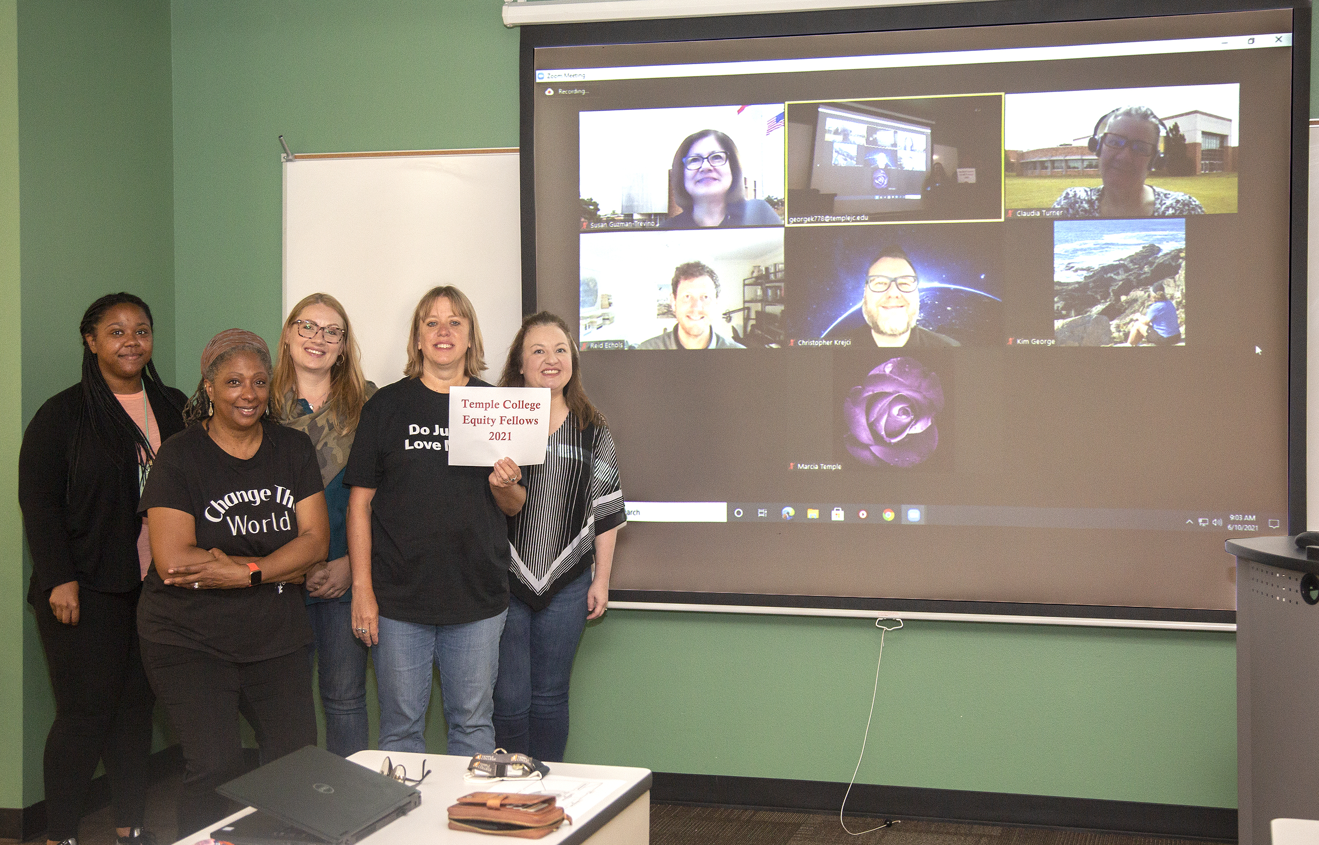
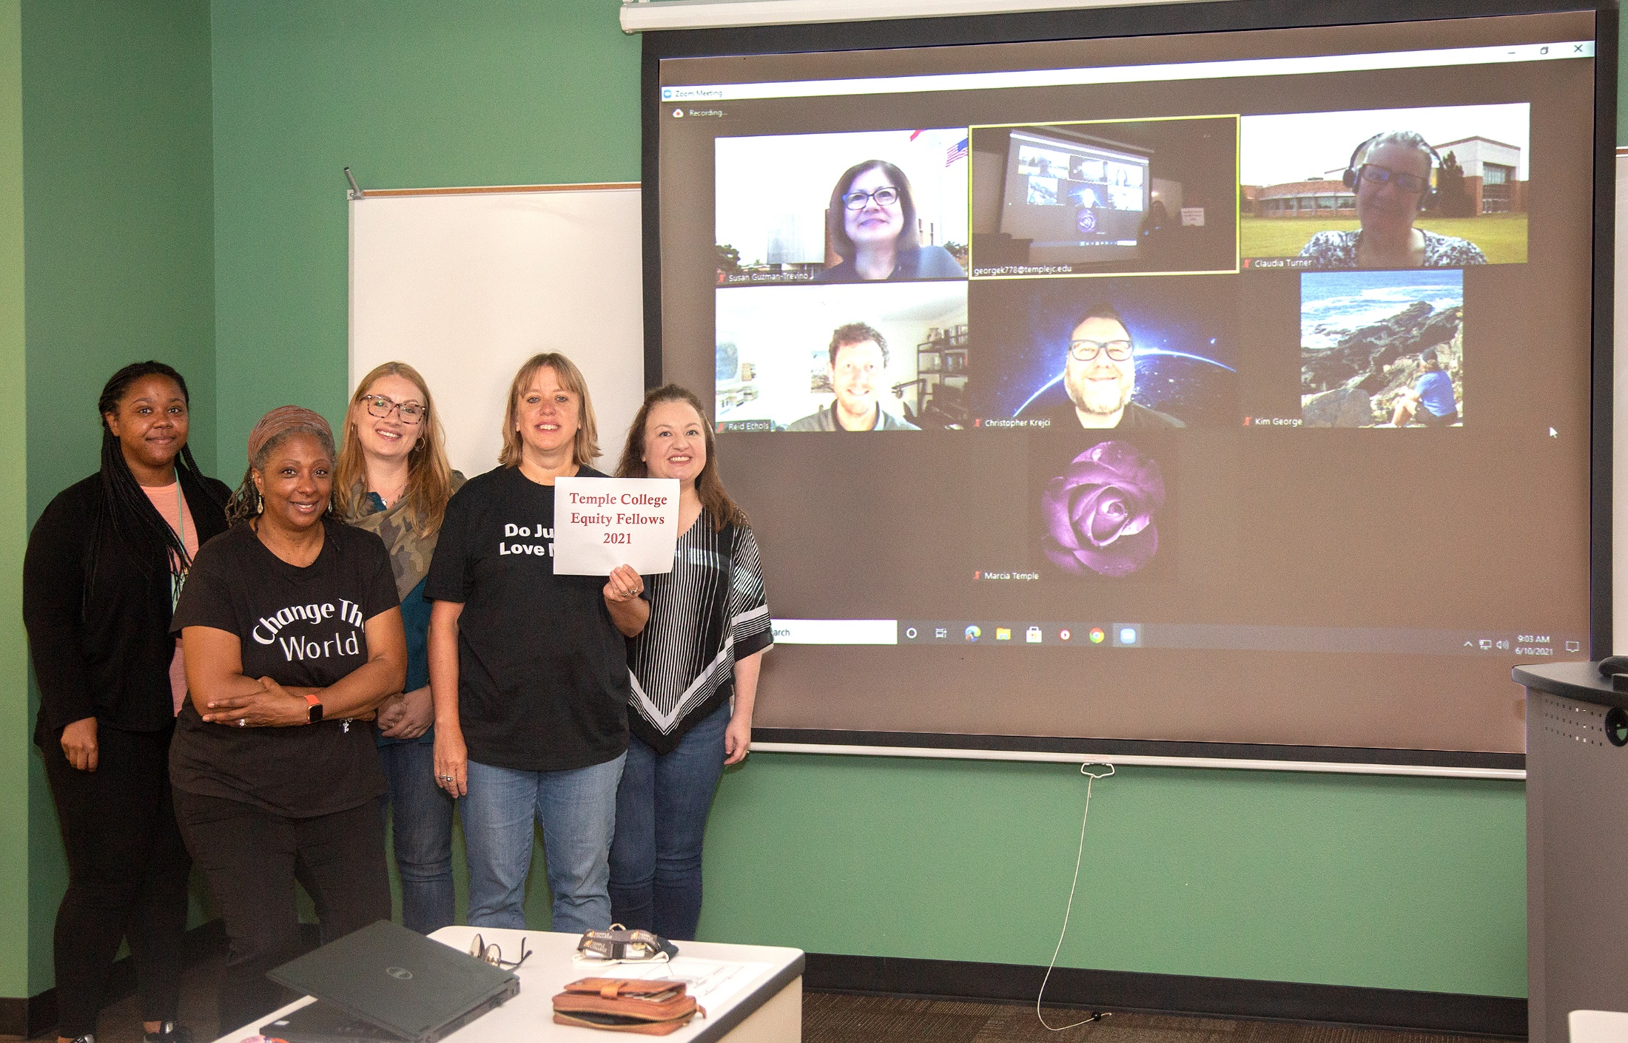

Slide 15
Equity Classroom Kim George
As a part of my equity work in the Equity Fellowship 2021, I focused on my most vulnerable student---the student who is returning, who may have children, who often has a job, and who often doubts him/herself. Many of these students do not feel confident and begin to back out before they have even given college a chance.
My Goal was for those who self-identify as returning students to stay in the class longer and be more successful. My goal also included building a relationship that would encourage students to contact me frequently with questions.
I incorporated several best practices for equity class to achieve this:
1. A pre-course survey “Help Me Help You” where they address their concerns, their obstacles, and their goals.
2. More videos and links to use technology in a just-in-time format
3. A new deadline format with benchmark dates and more flexibility in submission of work
4. Reformat of my class content to focus all materials on real-life skills and the relevance of each activity.
5. The use of a video about “imposter syndrome” sent to those returning to school

Slide 16
Student Voices
I wanted to thank you for the YouTube link you sent me on D2L about the Imposter Syndrome video, it took me a little while to notice it but I saw it at just the right time.
I am a working mom of two little boys, so prioritizing time to get my schoolwork done will be a challenge. I am thankful that we have posted deadlines to make getting the coursework done more flexible.
Taking your class was such a blessing for me as a returning older student. Thank you for taking the time, in the beginning, to teach us about how the whole system works D2L, discussion boards, etc. I was also telling my husband that thanks to you and this class, I learned different technical skills.

Slide 21
Best Practices: Peer Review Checklist

Slide 22
Next Steps and Opportunities:
Engage more faculty and staff
Listen to students
Share
Focus on Equity-Mindedness
Policies
Onboarding and Hiring Processes
Collaborative environment
Build Equity, Community, and Relationships for a stronger foundation

Slide 23
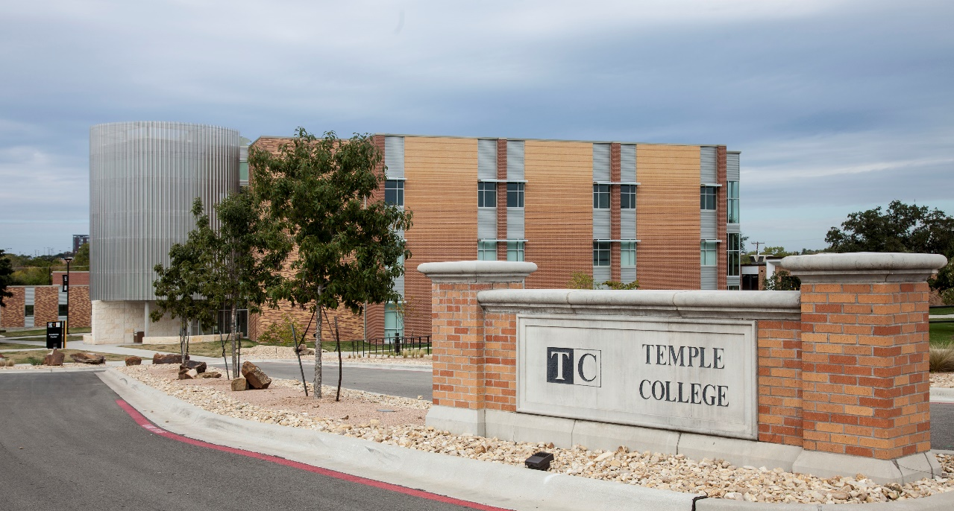
Questions?
Dr. Susan Guzmán-Treviño
Provost, Vice President, Academic Affairs and Student Services
Susan.guzmantrevino@templejc.edu
254-298-8340
Thank You!

