Slide 1
Yes!
8-Week Courses Work for Your
Under-prepared Students.
100% Corequisite in an 8-week Model

Slide 2
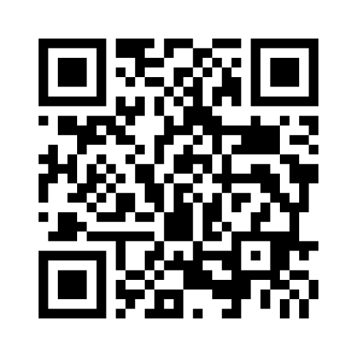
During our session participants will interact using Menti-meter. Please join us using the information below.
Scan the QR code to go to Menti-meter
Or go to www.menti.com
and use the code 3962 3578
*Please keep this app open
throughout the presentation

Slide 3
Contributors
Becky Easton, Dean of Liberal Arts
Edie Carter, Dean of STEM
Cathy Frazer, Chair, English and Cultural Studies
Penelope Davies, Chair, Mathematics, Engineering, Drafting, Data Science

Slide 4
Ripples of Change
1. 16-week sequential Dev Ed courses (2013-2015)
2. 8-week sequential Dev Ed/Transfer pairings (2016-2018)
3. 100% 8-week concurrent Corequisite courses (2019-Current)
Equals Completion

Slide 5
Why So Much Change?
Data Driven Institution
National Movement to Corequisite Model
AC’s 2020 Strategic Plan
State Mandates

Slide 6
How AC Prepared For The Big Change
Communication
National Experts
Faculty Involvement
PASS (Plan for Achieving Student Success)
PALS (Peer Assisted Learning Support)/Tutoring
Tutoring For Success Policy
Teacher Training and Support
Higher Education Opportunities
NOSS Accreditation

Slide 7
100% Co-req Model Rationale
Amarillo College’s decision to move to a 100% Dev Ed corequisite model was primarily based on data showing three-year completion was significantly correlated with full-time enrollment during a students first year.
Our rationale: By removing the traditional Dev Ed sequence, we would significantly increase full-time enrollment while maintaining course success rates in gateway transfer level English and math courses.

Slide 8
Maintaining Course Success Rates
We chose to measure course success by comparing Fall FTIC (first time in college) to Fall FTIC corequsite students. By saying we have maintained course success it means there is no statistically significant difference in course success between the two groups.

Slide 9
College Level Math Key
The following slides show data for Fall FTIC students between Fall 2019 and Fall 2021 that were successful in one of the following college level math courses disaggregated by corequisite status: MATH-1314, MATH-1324, MATH-1332, MATH-1414.
coreq_math = Y (student was in a paired corequisite course)
Coreq_math = N (student was in a regular college level course)

Slide 10
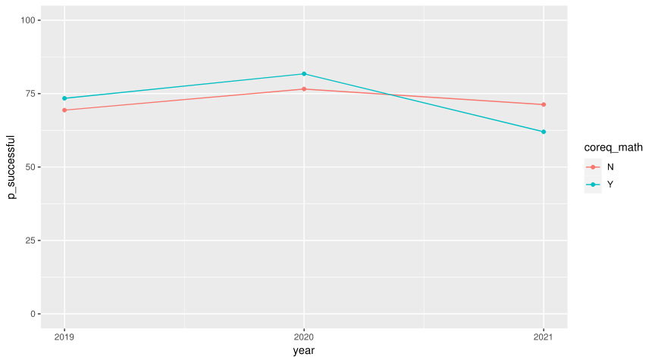
College Level Math Course Success
As you can see from the following data, the two groups are comparable. We maintained course success.

Slide 11
year | coreq_math | total | n_successful | p_successful
2019 | N | 307 | 213 | 69.38
2019 | Y | 252 | 185 | 73.41
2020 | N | 222 | 170 | 76.58
2020 | Y | 137 | 112 | 81.75
2021 | N | 282 | 201 | 71.28
2021 | Y | 200 | 124 | 62

Slide 12
College Level English Key
The following slides show data for Fall FTIC students between Fall 2019 and Fall 2021 that were successful in transfer level English 1301 (Freshmen Composition) disaggregated by corequisite status.
coreq_eng1 = Y (student was in a paired corequisite course)
coreq_eng1 = N (student was in a regular college level course)

Slide 13
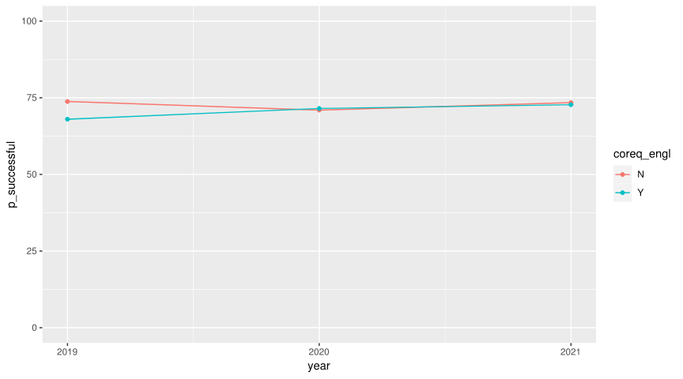
College Level English Course Success
As you can see from the following data, the two groups are comparable. We maintained course success.

Slide 14
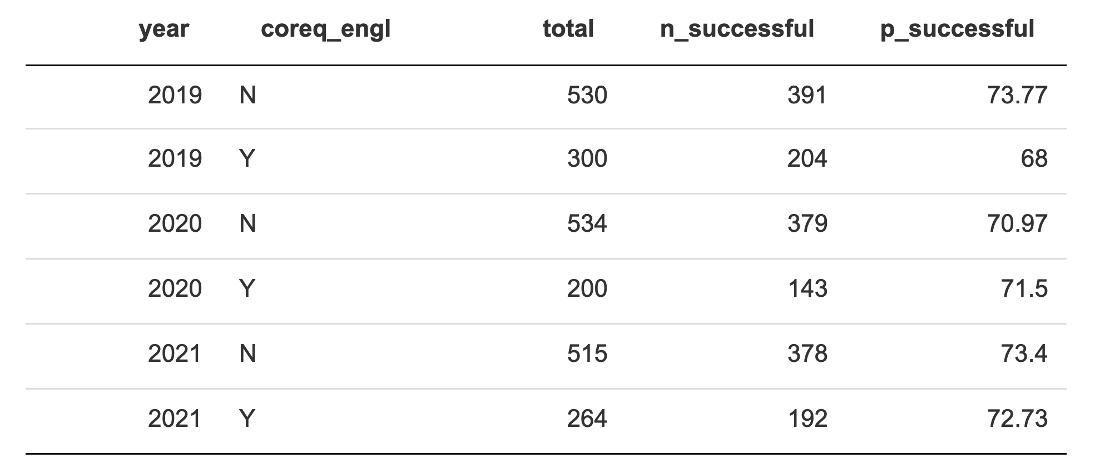

Slide 15
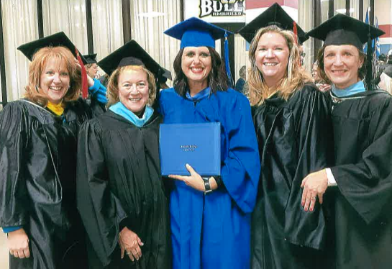
Faculty Experience
Faculty Training
High engagement
Course Design
Aligned Curricular Model in INRW/English
Four Math Pathways
Ongoing review & refinement
Team Teaching

Slide 16
Student Experience
College-wide Tutoring for Success Policy
Transfer Instructor
Corequisite Instructor
Dedicated Classroom Tutor
Academic Success Center
Peer Study Groups
Advising

Slide 17
“I was very impressed by the support I received during the course of this class.” “My instructors were both extraordinary teachers and were willing to go above and beyond to make sure the course content got taught in a timely but helpful manner.” “Between the teachers and Inquizative, I had all the resources I needed to study.” “…by far the best class I have ever taken and the first math class that I actually felt I understood.” “Tutoring has made a huge difference for me.” “My professor, in the co-req, has done an amazing job helping her students understand the material, and she was always available to help anyone who had questions.”
Student Comments

Slide 18
Lessons Learned
Consistent messaging about the offerings
Clear expectations from day one
Aligned syllabi
Students enrolled in only co-req for 8-week term
Classes hard-linked together, drop one, drop both
Continuous refining of program

