Slide 1
TACE: Who we are and How we can help!
Presented by:
Christina Bergvall- College of the Mainland; TACE President
Whitney McBee- Panola College; TACE East Region Representative
Jay Warnick- South Plains College; TACE West Region Representative
Sheridan Nixon-Dallas College; TACE affiliate

Slide 2
TACE
Promote the development of quality Continuing Education and Workforce programs
Professional development of Texas public community college Continuing Education programs
Mission incorporates 7 aspects
Network
Updates
Professionalism
Funding
Business pipeline
Business partnerships
Community

Slide 3
TACE
How do we execute our mission?
Member Driven
Region Representatives- Central, East, North, South, West, Southeast
Active Board
Healthcare Subcommittee
Virtual Meetings- October 28th, 2021
Annual Conference- April 20-22, 2022
Conference Planning Committee
Determine relevant topics
Determine Keynote speakers
Maintain outreach to TWC, THECB, TACC, NCET

Slide 4
TACE
TACE memberships run from September 1st -August 31st regardless of when you join during the year.
Individual Member- An individual can become a TACE Individual Member with an annual fee of $50.
Institution Membership- A community college can obtain an Institution Membership. An institution membership includes 8 individual memberships. The cost for an institution membership is $200.
Sponsor-TACE has opportunities for sponsors and partners to maintain contact with our membership at various levels.

Slide 5
Focus: Enrollment Strategy
Obstacles to Enrollment:
CE Students have limited funding resources
TPEG, Scholarships, Reskilling
HSE/Diploma is required for most healthcare programs
Both program application and FA application can be intimidating (immunizations, FAFSA)
Department has limited staff and time
TACE Mission:
“To maintain a communication network and arena for mutual association and the exchange of ideas among professionals in continuing and workforce education.”

Slide 6
Focus: Enrollment Strategy

Slide 9
Focus: Enrollment Strategy
Solution:
1st- Find Money
2nd- Find Support
TACE Conference and Connections
Braided Funding Concept
Leveraged our partnership with Adult Education staff

Slide 10
Focus: Enrollment Strategy
Implementation:
Goal: Route students to Adult Education Career Navigators for wrap-around services
Currently transferring students via phone or email until application is available
Application includes link to schedule an appointment with a Career Navigator

Slide 12
Focus: Enrollment Strategy
Focus on fundamental issue(s) and solutions within reach
Leverage connections for realistic change in real time
Include partners in the strategic development and implementation processes

Slide 13
Levelland Community QuickBooks Training
TACE Mission:
“To assist business, government, and industry with their "on-going" training and educational needs by placing them in contact with a local community/junior college”

Slide 14
Levelland Community QuickBooks Training
Work with Local City Government Agencies
Levelland Chamber of Commerce / Levelland Economic Development Corp (LEDC)
Businesses and Individuals
LEDC Scholarship $458.00 Per Student Covers the Cost of the Class
TACE Mission:
“To assist business, government, and industry with their "on-going" training and educational needs by placing them in contact with a local community/junior college”

Slide 15
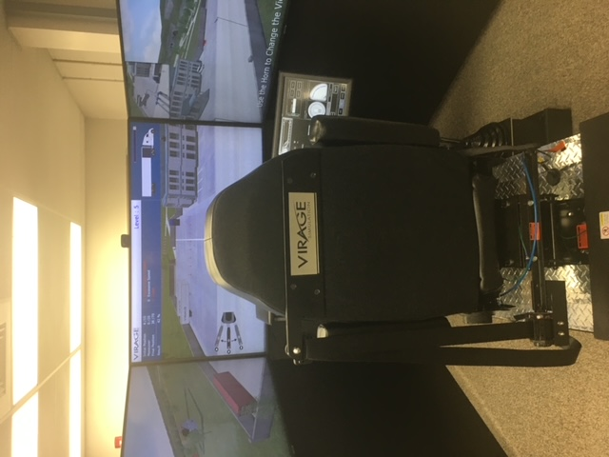
Tractor Trailer High Tech Simulators
TACE Mission:
“To maintain a communication network and arena for mutual association and the exchange of ideas among professionals in continuing and workforce education”

Slide 16
Tractor Trailer High Tech Simulators
Regional TACE Meetings
TACE Members Collaboration
Lubbock Economic Development Alliance (LEDA) / Workforce Solutions South Plains
Texas Workforce Commission Grant $250,000.00
LEDA Donation $150,000.00
TACE Mission:
“To maintain a communication network and arena for mutual association and the exchange of ideas among professionals in continuing and workforce education”

Slide 17
A Bleak Pathway
Less than 10% will complete a college degree 6 years after high school graduation
80% of Dallas College students come from underserved populations
A

Slide 18
The TRUE Workforce Initiative
Identify high-priority credentials and foundational career specific skills
Design and implement high-quality short-term and micro-credentials aligned with regional demand
"To support professionalism, integrity, and quality continuing and workforce education programs in Texas."
TACE Mission
Create program maps to credentials, including opportunities for careers, further education, and related wages Deliverables

Slide 19
Expanding Known Success Strategies
Concierge Onboarding & Registration Services
“No more students lost in the admission cycle”
Intrusive Success Coaching
“Just-in-time early intervention”
Pathways
With Structured Support
“Built-in guardrails on & off ramps”
Embedded Instructional Success Facilitators
“Academic supports to enhance learning”
Complete Industry Buy-in
“Connecting learning to work”
Customized Instructional Delivery Solutions
“The right modality and format at the right time”
Career Connected Learning
“Capitalizing on enroll in a job approaches”
ABILITY TO SCALE QUICKLY
SENSE OF URGENCY

Slide 20
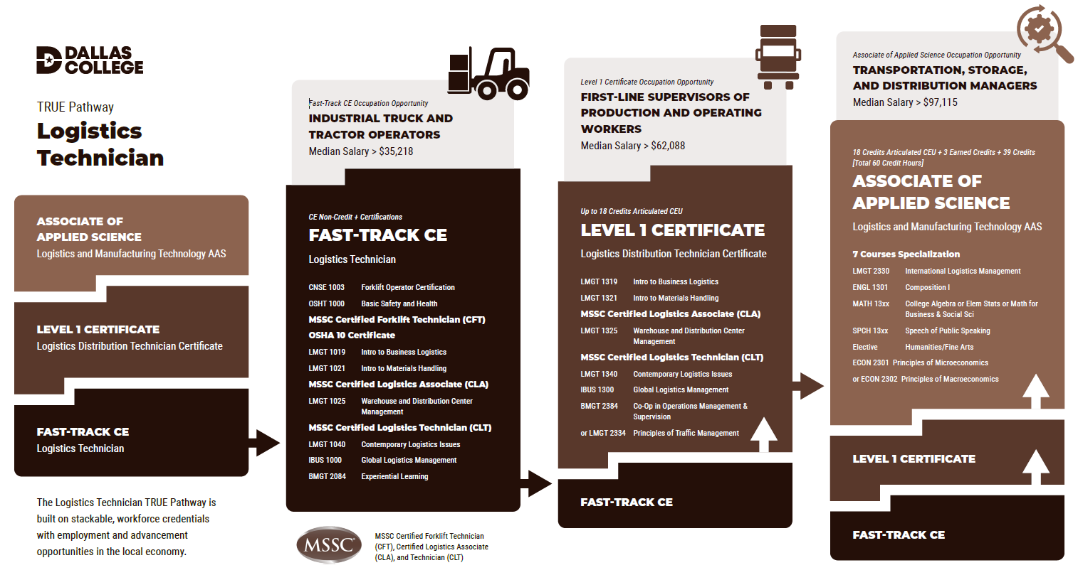
True Pathways In Practice- Logistics Technician
Dallas College

Slide 21
Contact information
Christina Bergvall- cbergvall@com.edu
Whitney McBee- wmcbee@panola.edu
Sheridan Nixon- snixon@dcccd.edu
Jay Warnick- jwarnick@southplainscollege.edu

